Slide 1







BOX OFFICE
Team Members : | Guide Name Mrs.R.UmaMaheswari GROUP - 15
1) Eshwar N R (Leader)
2) Varunprasanna S
3) Venkateshwara Murthy D
4) Rajesh R
Disclaimer: The content is curated for educational purposes only.

Slide 2

BOX OFFICE
OUTLINE
Abstract
Problem Statement
Aims, Objective & Proposed System/Solution
System Design/Architecture
System Development Approach (Technology Used)
Algorithm & Deployment
Conclusion
Future Scope
References
Video of the Project
Notes:
These are the list of chapters that we are going to cover in these foundation codes. Those are chapter one what are AI and ML? chapter 2 applied Python programming in AI, and chapter 3 is exploratory data analysis for ML.

Slide 3

Abstract
To satisfy the users by displaying the genre of movie along with the descriptions, cast, rating.
So user can able to choose his genre of movies.

Slide 4

Problem Statement
To Develop a comprehensive movie review project that includes a user-friendly interface for choosing his genre of movies and their description ,cast and rating.

Slide 5
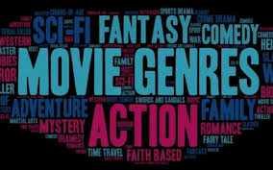
Aim and Objective
User can able to find his genre of movies.
User can able to know the ratings.
User can able to get a clarity about description, and cast about the movie.

Slide 6

Proposed Solution
The users can choose their preferred movies and also user can able to see what kind of movie (comedy, thriller, Fantasy,....).
So ,it will satisfy the user movie genre. User can able to know the rating, description and cast about the movie.

Slide 7

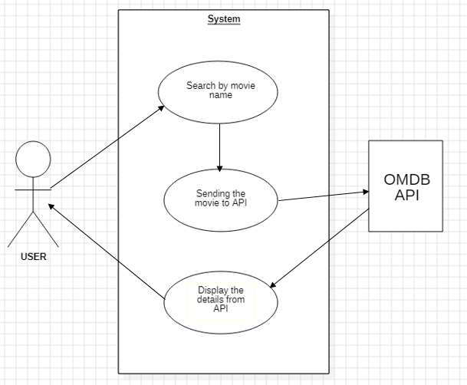
System Architecture

Slide 8

System Deployment Approach
The User Interface is structured by HTML .
The User Interface is designed by CSS .
JavaScript is used to get the name of the movie from the user.
OMDB API is used to get the details of the movie and the user interface will display the details of the movie to the user.

Slide 9

Algorithm & Deployment
OMDP API (Open Movie Database ):
The OMDb API is a RESTful web service to obtain movie information, all content and images on the site are contributed and maintained by our users.
It is used to fetch the details of the movie easily through internet,
It posses all the movies in a database .

Slide 10

Conclusion
“ The user will be satisfied by choosing his genre of movie and also its ratings, description and cast . ”

Slide 11

Future Scope
After the user chosen his genre of movie ,he can able to download the movie for watching using this project.

Slide 12





Reference
IMDB
Netflix
Amazon Prime video
Disney + Hotstar
Notes:
Reference
These are the references for this session.
12

Slide 13
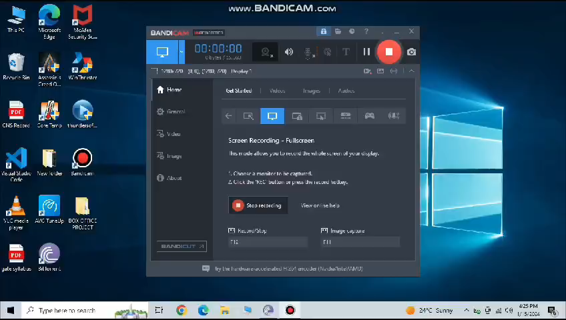
Video of the project
https://drive.google.com/file/d/1OD0S5QHa02FBP478zpE_fTV18gy49xJ6/view?usp=drivesdk

Slide 14
Github Link
https://rajesh302003.github.io/Box-Office/

Slide 15



